Slide 1
Hazard Communication (HAZCOM)
BROUGHT TO YOU BY: OESD 114
COLLEEN KRAGEN - SAFETY & HEALTH SPECIALIST

Slide 2
HAZCOM Changes from L&I
Notes:
Occupational Safety and Health Administration, (n.d.), https://www.osha.gov/dsg/hazcom/effectivedates.html.

Slide 3
What is an SDS?
A Safety Data Sheet (formerly called the Material Safety Data Sheet) is a document provided by a manufacturer that gives detailed information about a substance or material used in a workplace.

Slide 4
Safety Data Sheet (SDS) Continuity
As of June 1, 2015 all SDS are required to use the same format, include section numbers, headings, and associated information below the headings.

Slide 5
2 Major Changes in the 2012 Revision
1 – New Label Elements
2 – Safety Data Sheets
The new label elements and SDS requirements are designed to improve worker understanding of the hazards associated with chemicals in their workplace.

Slide 6
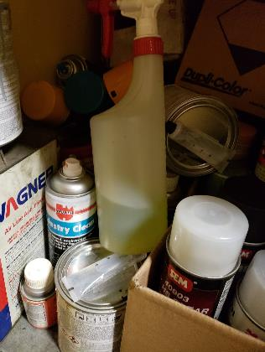
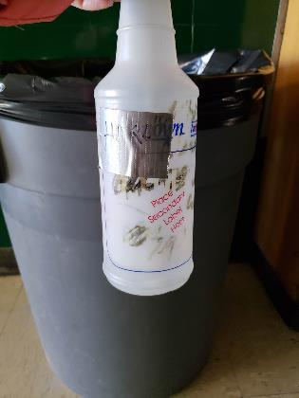
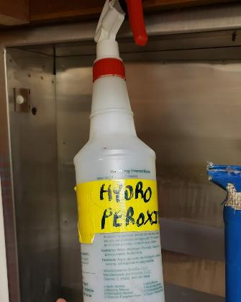
Knowing the Chemicals You Use

Slide 7
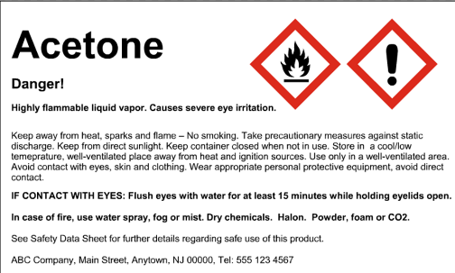
Proper Labeling
It is critical to properly label all chemicals that are not in their original containers. For example, if you use a smaller bottle or bucket place a printed label on the outside.
Notes:
Label example from https://www.lni.wa.gov/safety/TrainingPrevention/TrainingKits/hazcom/

Slide 8
Danger vs. Warning
DANGER: Used for more severe hazards
WARNING: Used for less severe hazards
There will only be ONE signal word on the label no matter how many hazards a chemical may have. Whether it’s Danger or Warning is determined by the most severe threat the chemical poses.

Slide 9
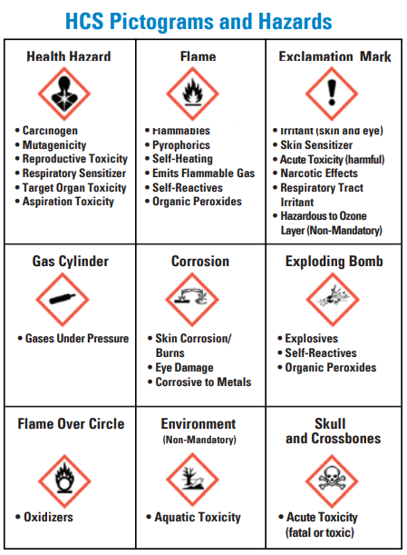
Standardized Pictograms
OSHA’s Quick Card one page handout in English and Spanish is available at https://www.osha.gov/dsg/hazcom/index.html, under the tab “Pictograms.”
The link has handouts, briefs, and quick references on safety data sheets, labeling, pictograms, standards, and more related to HAZCOM.
Notes:
Image from OSHA (2016) https://www.osha.gov/Publications/OSHA3491QuickCardPictogram.pdf

Slide 10
New SDS Format: 16 Sections
Section 1: Identification
Section 2: Hazard(s) Identification
Section 3: Composition/Information on Ingredients
Section 4: First Aid Measures
Section 5: Fire Fighting Measures
Section 6: Accidental Release Measures
Section 7: Handling & Storage
Section 8: Exposure Controls/Personal Protection

Slide 11
New SDS Format: Cont.
Section 9: Physical & Chemical Properties
Section 10: Stability & Reactivity
Section 11: Toxicological Info
Section 12: Ecological Info
Section 13: Disposal Considerations
Section 14: Transport Info
Section 15: Regulatory Info
Section 16: Other Info

Slide 12
Section 4
Notes:
Occupational Safety and Health Administration (2012), retrieved from https://www.osha.gov/Publications/OSHA3514.pdf.

Slide 13
Section 4: First Aid Measures
Instructions for an untrained responder to assist an individual who has been exposed to the chemical
Necessary first-aid instructions based on relevant types of exposure (inhalation, skin or eye contact, and ingestion)

Slide 14
Section 4: First Aid Measures Cont.
Recommendations for immediate medical care and special treatment if needed.
Description of the most significant symptoms or effects, and any symptoms that may be acute or delayed.
Notes:
Images from https://www.lni.wa.gov/safety/TrainingPrevention/TrainingKits/hazcom/

Slide 15
Section 8
Notes:
Occupational Safety and Health Administration (2012), retrieved from https://www.osha.gov/Publications/OSHA3514.pdf.

Slide 16
Section 8: Exposure Controls & Personal Protection
Exposure limits: i.e. if it is hot outside, there can be a limit to how long you can work before needing a break or changing locations.

Slide 17
Section 8: Exposure Controls & Personal Protection
Engineering Controls: A/C, equipment guards, ventilation, emergency shut off switches, etc.

Slide 18
Section 8: Exposure Controls & Personal Protection
Personal Protective Equipment: respirator, dust mask, goggles, gloves (chemical, hot pads, cut-proof), protective clothing.
If it doesn’t fit, it’s not proper PPE!

Slide 19
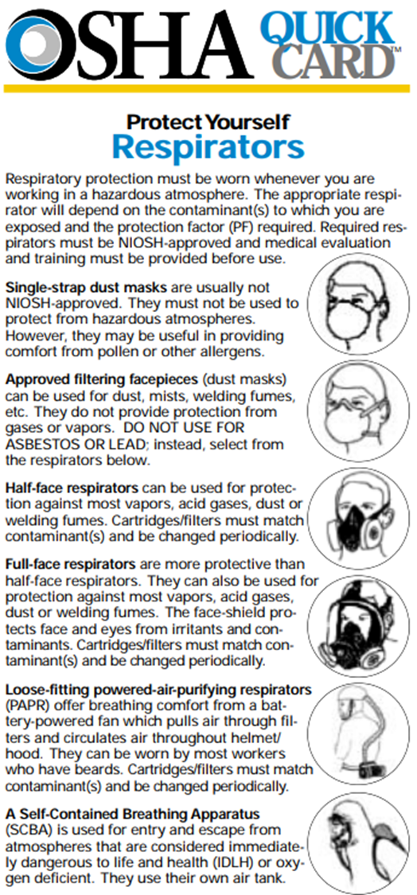
Choosing the Right Tool for the Job
Section 8 will identify if PPE is needed, although sometimes the description of the type of PPE is vague. NIOSH, DOSH, & ANSI regulations can fill in gaps on what specific model of PPE meets standards.
This list on the right is from OSHA that breaks down the hazards and which type of mask/respirator is needed. “NIOSH approved” is left open because the regulations are updated as information changes.
Once the hazard is identified the employer can use the OSHA list to determine what type of mask is needed, then an internet search can be done for the current NIOSH approved version of that type of mask/respirator.
Notes:
Occupational Safety and Health Administration, (n.d.), retrieved from https://www.osha.gov/OshDoc/data_Hurricane_Facts/respirators.pdf.

Slide 20
At the end of the day ...
We want you to go home safe and enjoy yourself!

Slide 21
Thank you!
Colleen Kragen
+1 360-515-8225
ckragen@oesd114.org
https://www.oesd114.org/Page/423

