Slide 1
Accident Prevention Program (APP) for School Districts
Colleen Kragen – Safety & Health Specialist
Last Revision – February 2020

Slide 2
Topics
Accident Prevention Program (APP) Explained
Components of a Successful Plan
Reporting Incidents
New Employee Orientation & Continued Training
Safety Committees

Slide 3
Accident Prevention Program
What is an APP?
Notes:
There are two APP templates provided, one is the short version that meets the minimum requirements, and the full APP that includes more detailed sections and supporting WACs for reference.

Slide 4
Definitions
An APP: is a plan designed around an organization’s operations that outlines actions taken to avoid, disrupt, or lower the severity of an accident before it happens.
Accidents: are unplanned or unexpected events that can lead to injury, long-term health problems, damage to property or the environment, and in the worst case – death.
Accident Prevention: includes any measures taken to reduce the frequency and the severity of foreseeable risks.
Notes:
More information: https://www.osha.gov/dsg/InjuryIllnessPreventionProgramsWhitePaper.html

Slide 5
Requirements
The Washington State Department of Labor & Industries (L & I) requires all employers to create a written APP, per WAC 296-800-140:
Identifying workplace hazards that could cause injuries
Plans to reduce or eliminate those hazards
How to report injuries, unsafe conditions, and first aid locations
A detailed safety orientation to employees so that they understand the possible hazards of their particular job and how to work safely
A Safety Committee
The use and care of Personal Protective Equipment
Emergency procedures and evacuation
Hazardous Communication including Safety Data Sheets instruction

Slide 6
Citations from L & I
L & I’s fines begin at $2500 for each citation
School districts that have received an L & I citation are on a 3 year probation period with regular re-inspections
Additional citations after an initial fine are considered willful and the fines increase dramatically in price
Notes:
Image by OpenClipart-Vectors from Pixabay

Slide 7
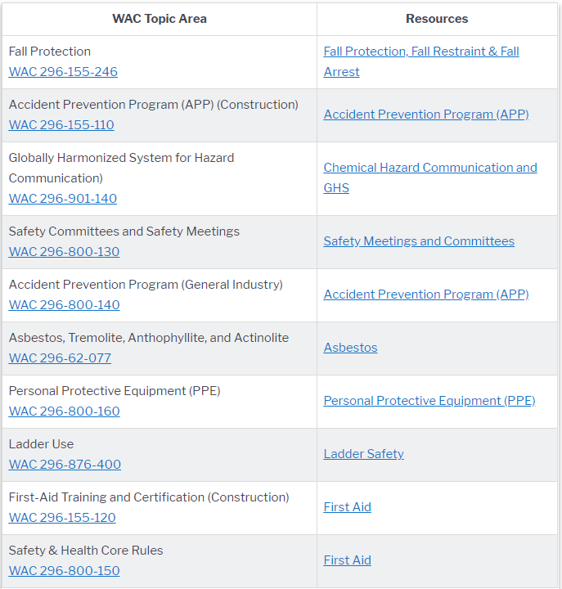
Top 10 Rule Violations from L&I 2019: All Industries
Notes:
Retrieved from Dept of Labor and Industries (n.d.): https://lni.wa.gov/safety-health/safety-rules/top-10-rule-violations

Slide 8
Compliance Benefits
Good will with L & I
Less injuries, less severe injuries, less near-misses
Insurance rates can be reduced with a reduction in claims
Fosters a culture of safety where employees feel valued
Notes:
Image by S K from Pixabay

Slide 9
Components of a Successful Plan
What does it take for a program to work well?

Slide 10
Risk Assessment
2 Impact Assessment
3 Mitigation Development
4 Implementation
5 Management
1 Identification
Hazards should be identified based on a risk assessment and considering factors such as injury claim history, national injury statistics based on job type, regulation requirements, and safety walkthroughs of workplace spaces.

Slide 11
Identifying Hazards
Accidents Can Happen Anywhere. Many Can Be Prevented.
Notes:
Image by Julian Gough from Pixabay

Slide 12
Claims Statistics Analysis
From Jan 2017 – Jan 2020 There are 132 Slip & Fall injury incidents reported per year for the WCT.
Slips & Falls are the second highest injury type and most can be prevented.
Misc. is where the cause of the incident is not provided changes in reporting procedures have improved information
These numbers can help guide your training and safety programs.

Slide 13
Mitigation Techniques
Remove Risks
Reduce the Impact
Replace stairs to a dumpster with a mechanical assist lever
Filling in potholes and cracks on walkways and in parking lots
Storing items with safe lifting in mind
Replacing worn out mats
Adjust desks and computers for proper ergonomic support
Use cable management to minimize trip hazards
Regular safety topic training

Slide 14
Safety Record Keeping
If it isn’t recorded it didn’t happen.
Records should be kept in a standard location where they can be easily accessed when needed.
SafeSchools offers a large variety of online training courses and tracks employee completion, records for individuals or courses can be printed for records.
For in-house training a simple sign-in sheet with a topic heading works as a record.
Maintenance records can be pre-use checklists, work-orders, and 3rd party contracts and invoices.

Slide 15
Backups – Hard Copies & In the Cloud
Notes:
Image by tookapic from Pixabay

Slide 16
Standard Equipment Checks & Records
Eyewash Stations – need to be activated weekly and maintenance checked annually
Fire Extinguishers – need to be checked and initialed monthly and maintenance checked annually
First Aid Kits – should be checked monthly and restocked as needed
Lifts (fork, aerial, scissor, etc.) – need a daily pre-use checkoff list, can be found in the manufacturers user manual
All mechanical equipment and power tools – should have preventative maintenance done per the manufacturers specifications, performed at least once a year
Notes:
Have checklist handouts for examples

Slide 17
Review All Plans & Updates
It is important to go back and review the changes that were made, once the hazards are removed, repairs are complete, and there is a schedule for future mitigations if needed.
Reviewing:
Can shed light on recurring issues that might need new solutions
Encourages people to look at their environment more carefully on a regular basis
Fosters a culture of safety and lets employees know their safety is a priority

Slide 18
Reporting Incidents
Reporting accidents and near-misses are important for understanding hazard risks

Slide 19
Employee Incident Reports (EIR)
OESD 114 Workers’ Comp Trust provides EIR forms for filing claims
These forms are available to all employees through your school district
An example of the EIR should be posted on all Safety Bulletin Boards in employee break areas
Incident reports can be used to submit an injury claim, or to report a near-miss that does not directly result in a claim
EIRs should be used for risk assessments, mitigating hazards, and safety committee topics
Personal information (names, claim numbers, SSN, etc.) should not be shared
Notes:
One of the handouts is a copy of the OESD 114 EIR

Slide 20
Near-Miss Reporting
Near-Miss is not a bad word
Help us identify areas for improvement
Provide us with an opportunity to prevent an accident before it happens
Allow us to prioritize safety concerns and plan for the future
Notes:
Image by Capri23auto from Pixabay

Slide 21
New Employee Orientation & Continued Training
What makes an effective training program?
Notes:
There is a handout with an example of an Employee Orientation Checkliist

Slide 22
Employee Safety Orientation Topics
SafeSchools training requirements and refresher schedule
General topics for all employees
Courses for specific job types
Emergency Response Plan
First Aid Kit & Fire Extinguisher Locations
Evacuation Procedures
Emergency Specific Procedures
Accident Reporting
Forms & Locations
Job Specific Hazard Training
Job Hazard Analysis (JHA), training to be provided by individual’s supervisor
Personal Protective Equipment (PPE) necessary for the job
Safety Data Sheets (SDS) for chemicals used on the job
Building Security Measures
Public entry doors
Sign-in sheets
Badges & Door Keys

Slide 23
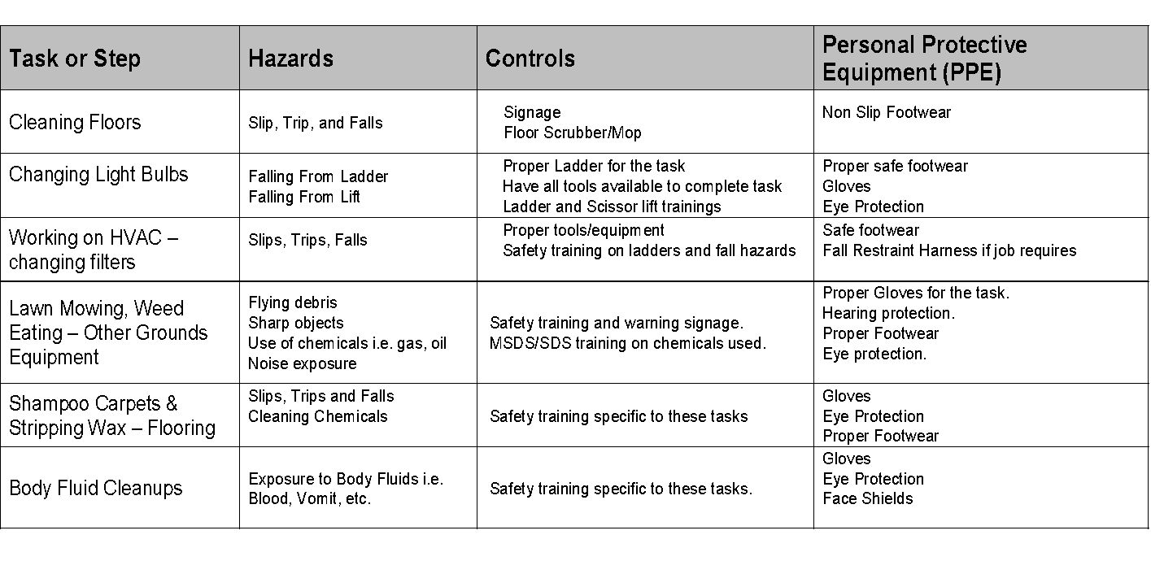
JHA Examples
Notes:
Table developed by OESD S&H, based off of multiple JHA templates from LnI and OSHA

Slide 24
Safety & Health Training Program All Employees Example
SafeSchools Course
Frequency of Refresher
Accident Prevention Program
Hazardous Communication
Back Injury Prevention
Slip & Fall Prevention
Repetitive Trauma / Ergonomics
Sprain / Strain Prevention
Bloodborne Pathogens
Emergency Procedures
Initial / Changes
Initial / Changes
Initial / 3 years
Initial / Annual
Initial / 3 years
Initial / Annual
Initial / Annual
Initial / Changes
Notes:
An example of the training program can be found in the full APP on page 11

Slide 25
Safety & Health Training Program for Maintenance & Custodial Example
SafeSchools Course
Refresher Frequency
Slips, Trips, & Falls: Custodians, Maintenance, & Facilities
Back Injury Lifting: Complete
Ladder Safety
Personal Protective Equipment (PPE)
CPR / First Aid
Asbestos Awareness
Initial / 2 years
Initial / 2 years
Initial / Annual
Initial / 3 years
Initial / 2 years
Initial (2 hr. course) / Annual (20 min. course)

Slide 26
10 Minute Break
Next topics – Safety Committees, Hazardous Communications (HAZCOM) ,Personal Protective Equipment (PPE), and First Aid

Slide 27
Safety Committees

Slide 28
Safety Committee Requirements
Safety Committees are required for any organization that has 11 or more employees working on the same shift at the same location.
Every School District requires a district level committee that meets at least quarterly with an equal number of employee elected members and employee selected members to verify fair representation of all employees. The Chairperson is always elected.
Elected members serve for one year and then new elections are held.
Some School District departments may also meet the committee requirements and they will have sub-committees.
Meetings are no longer than an hour unless otherwise written.

Slide 29
Safety Committee Topics
Required
Other Examples
Review safety & health inspection / incident reports
Evaluate accident investigations that occurred after the last meeting
Review corrections made based on incident and hazard reports
Evaluate safety programs
Seasonal safety issues
L & I common citations
Reporting near-misses
Proper use of eyewash stations and fire extinguishers
Building security procedures
Stretching exercises to prevent injuries
How to reduce clutter

Slide 30
Safety Committee Record Keeping & Reporting
Have a sign-in sheet
Prepare an Agenda to stay on topic
Meeting minutes should be posted on the Safety Boards and made available to all employees (also can be emailed and posted on the school district internal website)
Keep all records in a safe place

Slide 31
HAZCOM, PPE, & First Aid Sections of the APP
Using Safety Data Sheets (SDS) , proper Personal Protective Equipment (PPE), and First Aid requirements for schools

Slide 32
HAZCOM Program as of 2015
Notes:
Occupational Safety and Health Administration, (n.d.), https://www.osha.gov/dsg/hazcom/effectivedates.html.

Slide 33
2 Major Changes in the Revision
The new label elements and SDS requirements are designed to improve worker understanding of the hazards associated with chemicals in their workplace.
New Label Elements
Safety Data Sheets

Slide 34
Consistency with Safety Data Sheets (SDS)
A Safety Data Sheet (formerly called the Material Safety Data Sheet) is a document provided by a manufacturer that gives detailed information about a substance or material used in a workplace.
As of June 1, 2015 all SDS are required to use the same format, include section numbers, headings, and associated information below the headings.

Slide 35
List of Chemicals Required at Each Site
Chemical Name | Manufacturer | Location Used
Disinfecting Wipes | Seventh Generation | Conference Room 303
Free & Clear Dish Liquid | Seventh Generation | Staff Kitchen
All Purpose Natural Cleaner | Seventh Generation | Custodial Closet #3
Chlorine Free Bleach | Seventh Generation | SPED Chemical Locker
Dishwasher Packs | Seventh Generation | Staff Kitchen
Laundry Detergent | Seventh Generation | Maintenance Shop
SafeSchools SDS program and MSDS Online allow Administrators to add an SDS to a specific location identified by the user. The user can print a list of chemicals by location that can be added to the APP.
Notes:
Example list created by WCT S&H

Slide 36
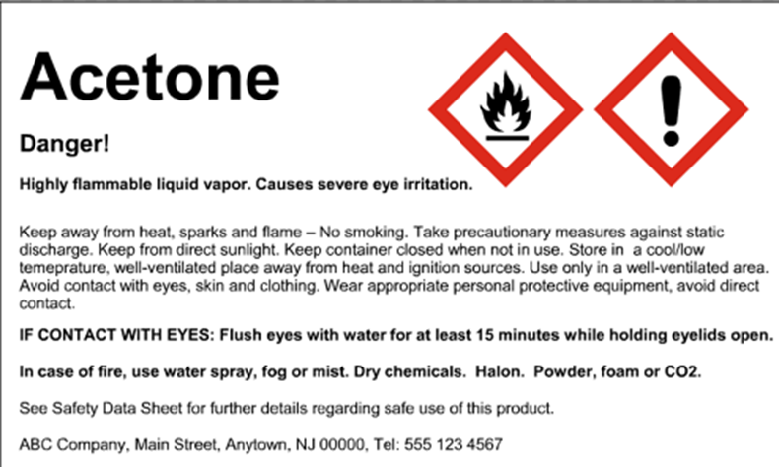
Secondary Labeling
It is critical to properly label all chemicals that are not in their original containers. For example, if you use a smaller bottle or bucket place a printed label on the outside.
Notes:
SafeSchools SDS program and MSDSonline both provide templates and easy printing for secondary labels. Label example from https://www.lni.wa.gov/safety/TrainingPrevention/TrainingKits/hazcom/

Slide 37
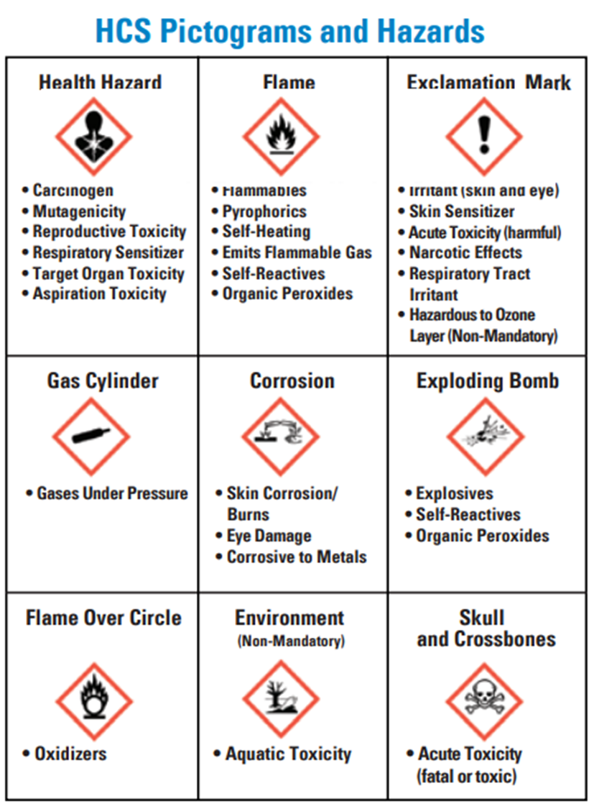
Standardized Pictograms
Notes:
Image from OSHA (2016) https://www.osha.gov/Publications/OSHA3491QuickCardPictogram.pdf

Slide 38
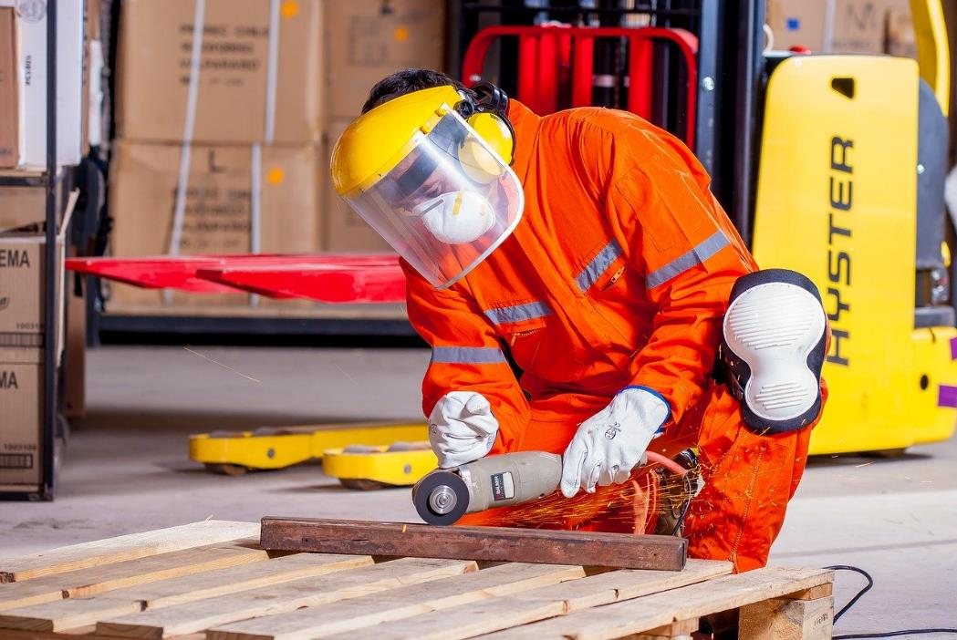
Personal Protective Equipment (PPE)
State Regulations (WAC’s) list PPE requirements based on job type.
SDS’ list PPE requirements and recommendations for specific chemicals.
The type of PPE required is determined by the hazards of the job.
Manufacturers list PPE requirements for specific equipment.
If it doesn’t fit, it’s not proper PPE!
Notes:
WAC 296-155-200 General requirements for personal protective equipment (PPE). Image by Yerson Retamal from Pixabay

Slide 39
PPE WACs Based on Task or Equipment
WAC 296-155-200
During hours of darkness, when employees' duties are performed in close proximity to moving vehicles, you must make sure that employees wear, at a minimum, a high-visibility safety vest, shirt, or jacket
WAC 296-155-211
Employees whose duties require them to operate a power chain saw must wear flexible ballistic nylon pads, sewn or otherwise fastened into the trousers, or other equivalent protection that will protect the vulnerable areas of the legs.
Notes:
These are just two examples.

Slide 40
SDS Section 8
Notes:
Occupational Safety and Health Administration (2012), retrieved from https://www.osha.gov/Publications/OSHA3514.pdf.

Slide 41
PPE Based on Risk Assessment
Identify the risks of the job and find an appropriate way to reduce possible injuries, i.e. outdoors:
High visibility clothes make the employee easy to see
Tall waterproof boots protect the employees feet and legs
Gloves prevent cuts and blisters to hands
In the cold additional layers keep the employee warm
Notes:
Image by Manfred Antranias Zimmer from Pixabay

Slide 42
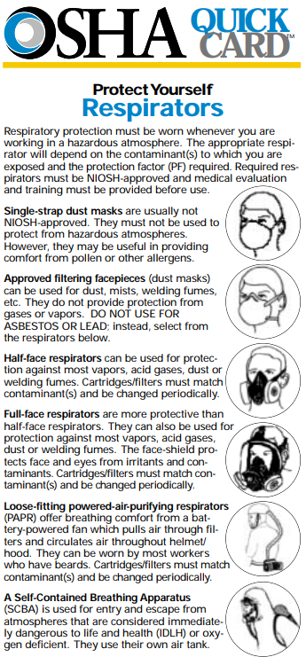
Choosing the Right Tool for the Job
Section 8 will identify if PPE is needed, although sometimes the description of the type of PPE is vague. NIOSH, DOSH, & ANSI regulations can fill in gaps on what specific model of PPE meets standards.
This list on the right is from OSHA that breaks down the hazards and which type of mask/respirator is needed. “NIOSH approved” is left open because the regulations are updated as information changes.
Once the hazard is identified the employer can use the OSHA list to determine what type of mask is needed, then an internet search can be done for the current NIOSH approved version of that type of mask/respirator.
Notes:
Occupational Safety and Health Administration, (n.d.), retrieved from https://www.osha.gov/OshDoc/data_Hurricane_Facts/respirators.pdf.

Slide 43
Cleaning & Maintaining PPE
Store PPE after cleaning and inspecting in an organized location
PPE must be inspected before each use
Some PPE require documented maintenance - follow manufacturers specifications
Harnesses and lanyards need to be inspected prior to use. If the do not meet manufacturers standards they need to be cut and removed from service.
Half-mask respirators require pre-use checks to ensure all parts are present and working. After every use they need to be cleaned and ideally stored in a clean locker, upright so the face plate does not get scratched.

Slide 44
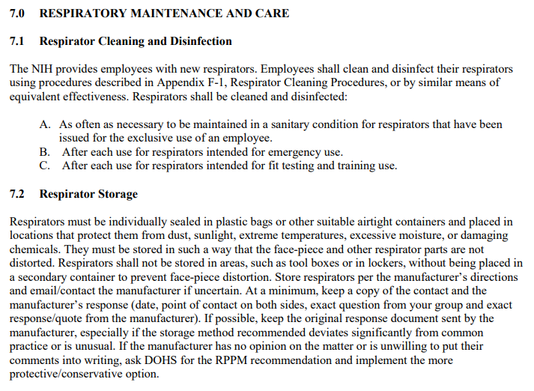
NIOSH Respirator Maintenance Example
Notes:
National Institutes of Health, (2018), retrieved from https://www.ors.od.nih.gov/sr/dohs/documents/respiratoryprotecttionprogram.pdf

Slide 45
Harness Maintenance Example

Slide 46
First Aid Training Regulations for Instructors & Bus Drivers
WAC 392-144-102: Bus Drivers
Current and valid First-Aid card
WAC 170-295-1100: Child Care Facilities
Schools with Child Care Facilities need one adult for every six children to have a current and valid First-Aid card and CPR certificate
WIAA handbook 02/03 rule 23.2.1 A&B: Coaches
First Aid card and CPR certificate
WAC 296-800-15005: Working away from medical care
Teachers with students on a trip and not near medical care need to have a valid First Aid card

Slide 47
First Aid Training Regulation for Maintenance/Custodial
WAC 296-155-120: School maintenance persons (and others) are covered by this rule when doing work designated as “construction work.” This includes construction, alteration, demolition, related inspections, and/or maintenance and repair work, including painting and decorating.
Each employer must have available at all worksites, where a crew is present, a person or persons holding a valid first-aid certificate.
All crew leaders, supervisors or persons in direct charge of one or more employees must have a valid first-aid certificate.
For the purposes of this section, a “crew” means a group of two or more employees working at any worksite.

Slide 48
When in Doubt - Train Extra Personnel
Quick, does anyone know first aid?!
Yeah ... them.
Notes:
Left Image by succo from Pixabay Right Image by succo from Pixabay

Slide 49
10 Minute Break
Next topic is specific programs to add to the APP

Slide 50
APP Tabs for All Districts
A Brief Introduction to: Bloodborne Pathogens, Outdoor Heat Exposure, Lockout/Tagout, Chemical Hygiene Plan, Hazardous Waste Management
Notes:
Hand out APP example sections

Slide 51
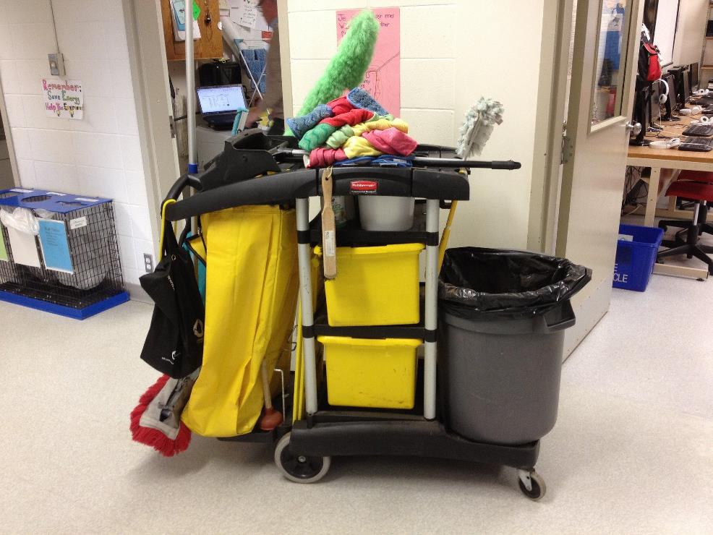
Bloodborne Pathogens Tab Topics
Training – through SafeSchools and in-house safety meetings
Universal Precautions – infection control for potentially infections materials
Exposure Determinations – job duties considered at risk (i.e. cleaning up after bodily fluids)
Notes:
Image by deepcove from Pixabay

Slide 52
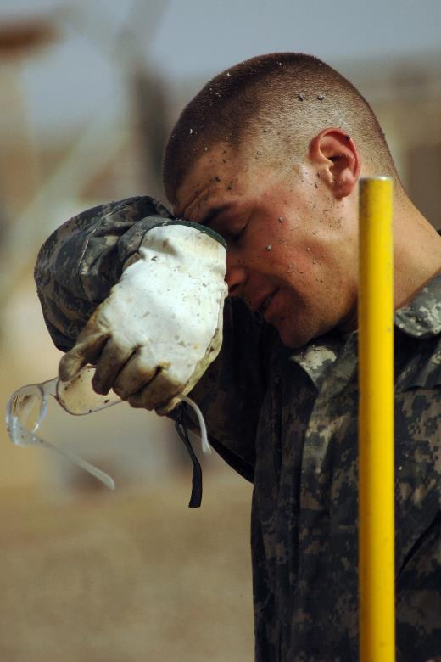
Outdoor Heat Exposure Tab Topics
Training – through SafeSchools and in-house safety meetings
Clothing – making adjustments for clothes and PPE, acclimatize
Hours – work outside in coolest hours of the day
Water – have plenty available
Heat Illness vs. Heat Exhaustion – symptoms, prevention, and treatments
Reporting and First Aid – follow standard procedures
Notes:
Image by skeeze from Pixabay

Slide 53
Lockout/Tagout Tab Topics
Training – through SafeSchools and in-house safety meetings
Authorization – who can place and remove locks/tags
Written Procedure – notifications, shutdown, placement of locks/tags, and removal
Notes:
Image by 8ocho8 from Pixabay

Slide 54
Chemical Hygiene Plan Topics
Science Labs – intended for science classrooms that use chemicals (chem., phys., etc.)
Training – Supervisors train all applicable employees on procedures
Identify who has what responsibilities in the plan
Control Measures – SDS, PPE, Inventory Lists, Signs, Records
Equipment – maintenance records, types, procedures
Notes:
Image by Gerd Altmann from Pixabay

Slide 55
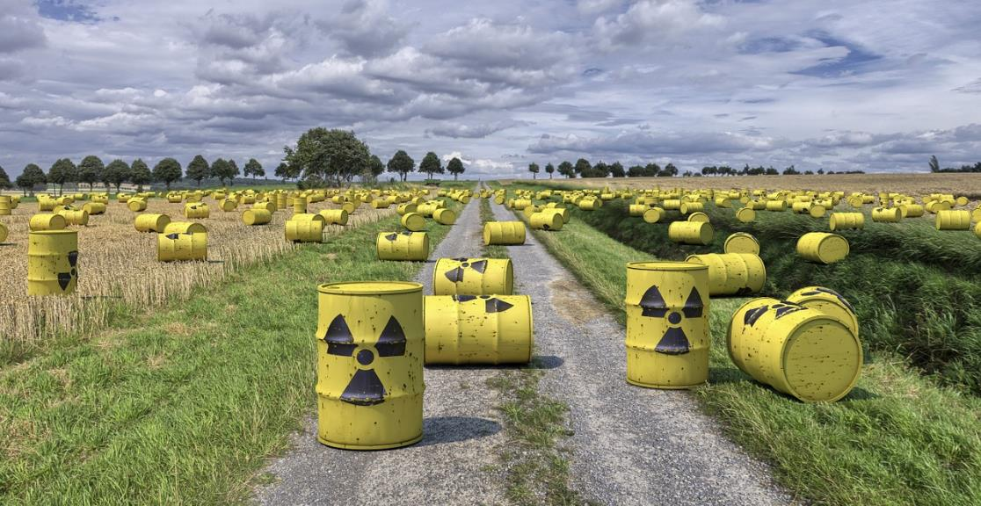
Hazardous Waste Management Tab Topics
Training – Supervisors train all applicable employees on procedures
Pick-ups – contact information for a known company to schedule regular or one-time pickups
Schedule – list month and frequency of regular pickups if applicable
! WARNING !
Jumping into toxic waste does not give you superpowers and may result in adverse health effects
Notes:
Image by Dirk Rabe from Pixabay

Slide 56
Additional APP Tabs As Needed
A Brief Introduction to: Fall Protection, Confined Spaces, Pesticide Management, Hearing Conservation, Respiratory Protection, Forklifts
Notes:
Hand out example APP sections

Slide 57
Fall Protection Tab Topics
Training – Supervisors train all applicable employees on procedures
Requirements – when fall protection is required and what type(s) can be used
Safety Watches – when and how to use a safety watch
Maintenance – pre-use checklists for equipment
Notes:
Image by Dorian Krauss from Pixabay

Slide 58
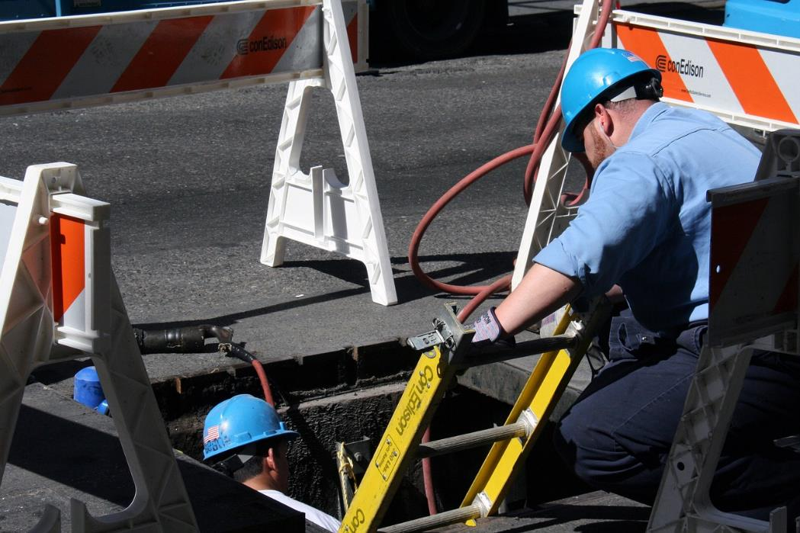
Confined Spaces Tab Topics
List of Spaces – identify all confined and permit required confined spaces
Specific Hazards – tight entry, atmosphere & gases, PPE, evacuation
Training – Supervisors train all applicable employees on procedures
Identify who has what responsibilities in the plan
Procedures for Contractors
Notes:
Image by Ncpancy from Pixabay

Slide 59
Pesticide Management Tab Topics
Training – requires a certification for those using chemical pest control methods
Identify roles & responsibilities
Hazard Assessment – identify types of pests
Procedures – PPE, records, SDS, preventative measures, notifications
Notes:
Photo by Mert Guller on Unsplash

Slide 60
Hearing Conservation Tab Topics
Training – Supervisors train all applicable employees on procedures
Hazard Assessment – identify areas of concern
Hearing Tests – audiometric testing upon hiring and then once a year afterwards
Signage – post hearing protection requirements where needed
PPE – provide required hearing protection and maintain them
Notes:
Photo by Jason Rosewell on Unsplash

Slide 61
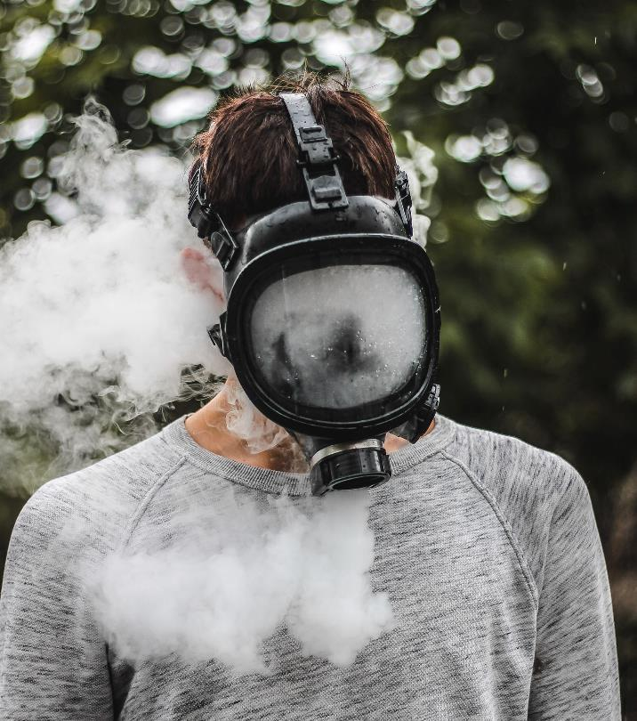
Respiratory Protection Tab Topics
Training – Supervisors train all applicable employees on procedures
Hazard Assessment – identify areas of concern and the correct respirator for the job
Medical Tests – respirator fit testing upon hiring and then once a year afterwards
Signage – post respirator requirements where needed
PPE – provide masks, replacement parts, and maintain them
Notes:
Photo by Pavel Anoshin on Unsplash

Slide 62
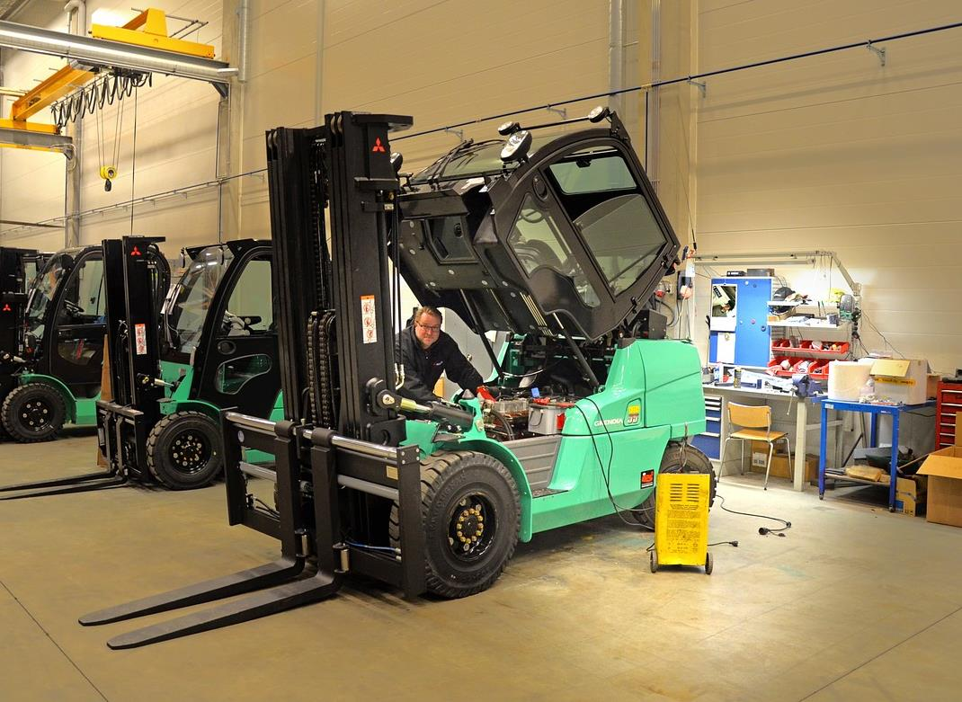
Lifts – Fork, Aerial, Scissor, Etc.
Training – through SafeSchools and practical application drive tests, can also be done through a 3rd party, refresher every 2 yrs
Equipment – pre-use daily checklists, operating procedures, regular maintenance records
Refueling – procedures for safe fueling and storage
Notes:
Image by Ilkka Kumpunen from Pixabay

Slide 63
Safety is a Way of Life
At the end of the day we want you to go home safe and enjoy life.
Notes:
Image by Ulrike Mai from Pixabay

Slide 64
Thank you!

